Slide 1

7th Grade Math
Unit 10, Lesson 1 Exploring Inequalities – Part 1 Volume 2, pg. 85

Slide 2


Benchmark
MA.7.AR.2.1
Write and solve one-step inequalities in one variable within a mathematical context and represent solutions algebraically or graphically.
volume 2, pg. 85

Slide 3
Integrated Mathematical Thinking and Reasoning Standards
MA.K12.MTR.1.1 Actively participate in effortful learning both individually and collectively.
MA.K12.MTR.2.1 Demonstrate understanding by representing problems in multiple ways.
MA.K12.MTR.4.1 Engage in discussions that reflect on the mathematical thinking of self and others.
MA.K12.MTR.6.1 Assess the reasonableness of solutions.
MA.K12.MTR.7.1 Apply mathematics to real-world contexts.
volume 2, pg. 85

Slide 4

Learning Targets
I can relate the solution set of an inequality to its graph on a number line.
I can relate the solution set of an inequality to the context it represents.
I can determine the minimum or maximum value that makes an inequality true.
volume 2, pg. 85

Slide 5

Warm-Up
volume 2, pg. 85

Slide 6
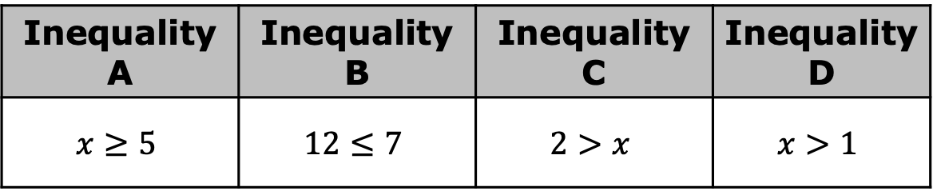
10.1.1 Warm-Up: Which One Doesn’t Belong?
Four inequalities are shown.
Javier says that Inequality B does not belong with the others. What is one reason Javier might have said this?
Select a different inequality and explain why it doesn’t belong.
Inequality A | Inequality B | Inequality C | Inequality D
$$x≥5$$ | $$12≤7$$ | $$2>x$$ | $$x>1$$
volume 2, pg. 85

Slide 7

Refresher
volume 2, pg. 86

Slide 8

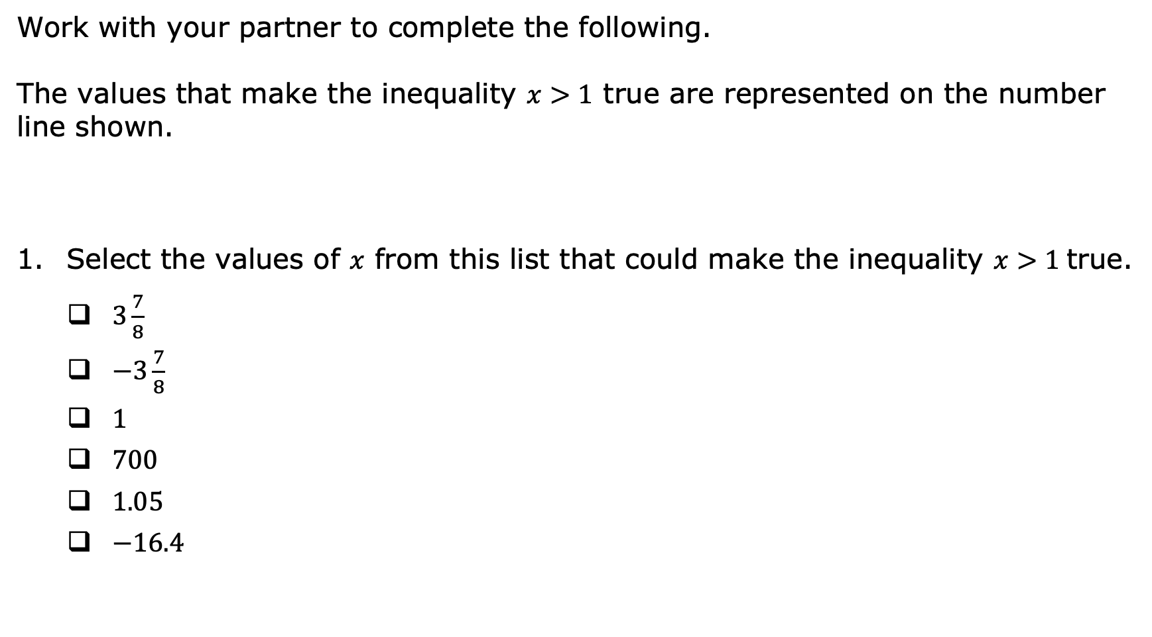
10.1.2 Refresher: Representing Inequalities on a Number Line
Work with your partner to complete the following.
The values that make the inequality $x>1$ true are represented on the number line shown.
Select the values of $x$ from this list that could make the inequality $x>1$true.
$3\frac{7}{8}$
$−3\frac{7}{8}$
$1$
$700$
$1.05$
$−16.4$
volume 2, pg. 86

Slide 9
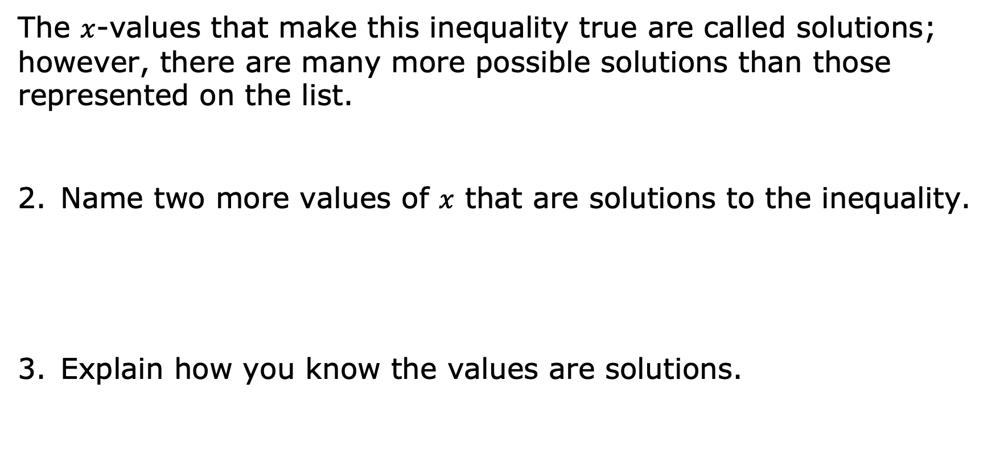
The $x$-values that make this inequality true are called solutions; however, there are many more possible solutions than those represented on the list.
Name two more values of $x$ that are solutions to the inequality.
Explain how you know the values are solutions.
volume 2, pg. 86

Slide 10
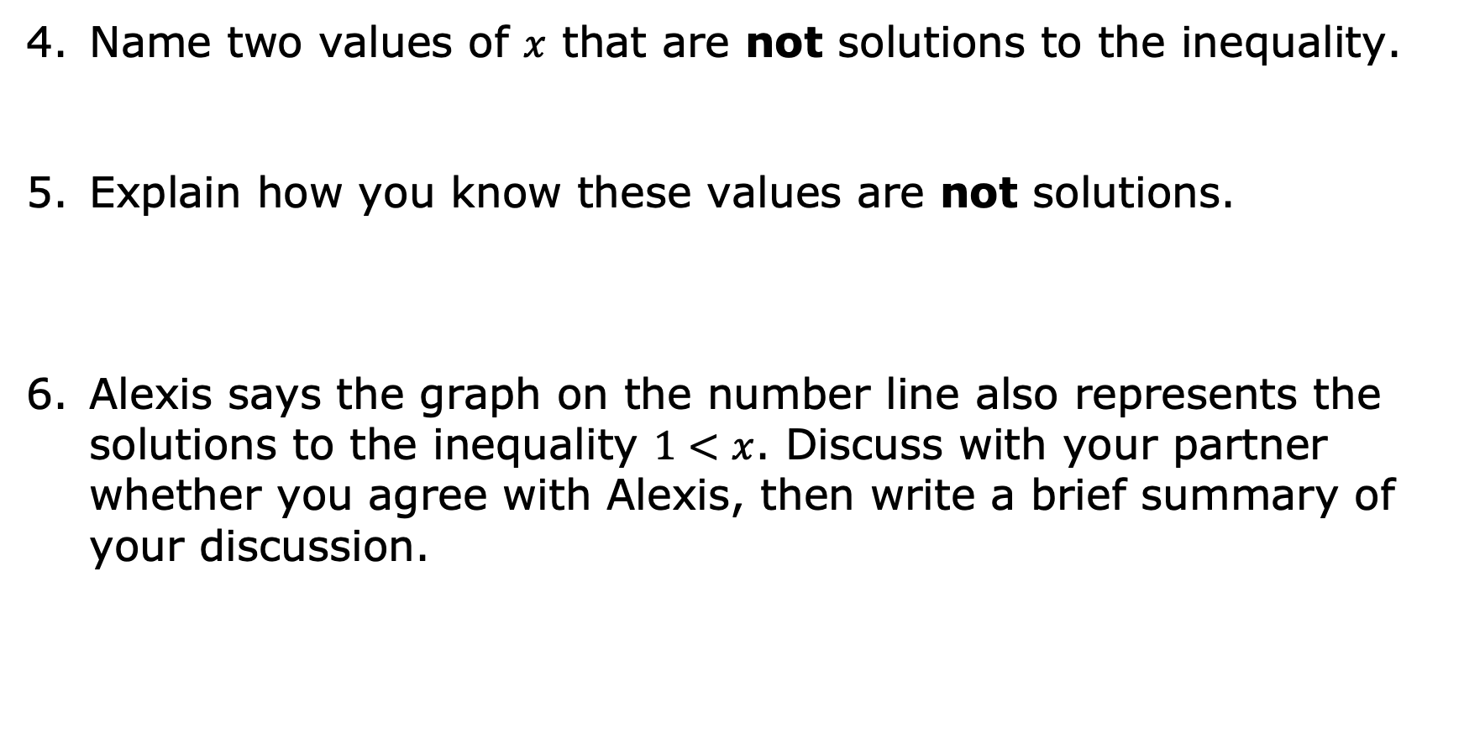
Name two values of $x$ that are not solutions to the inequality.
Explain how you know these values are not solutions.
Alexis says the graph on the number line also represents the solutions to the inequality $1<x$. Discuss with your partner whether you agree with Alexis, then write a brief summary of your discussion.
volume 2, pg. 86

Slide 11

Exploration
volume 2, pg. 87

Slide 12

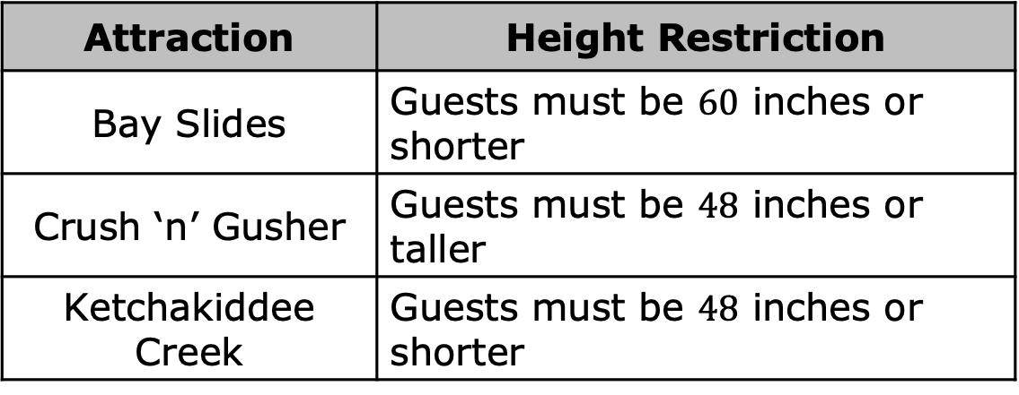
10.1.3 Exploration: Representing Inequalities in Context
Height restrictions are often in place for roller coasters and rides at amusement parks to keep guests safe. At Disney’s Typhoon Lagoon Water Park, the following height restrictions are in place.
Attraction | Height Restriction
Bay Slides | Guests must be $60$ inches or shorter
Crush ‘n’ Gusher | Guests must be $48$ inches or taller
Ketchakiddee Creek | Guests must be $48$ inches or shorter
volume 2, pg. 87

Slide 13
Work with your partner to determine which graph represents the height restrictions of each attraction at Typhoon Lagoon. Then, draw an arrow from each attraction to its matching graph.
Attraction
Bay Slides
Crush ‘n’ Gusher
Ketchakiddee Creek
Graph Representing Safe Heights for the Attraction
volume 2, pg. 87

Slide 14
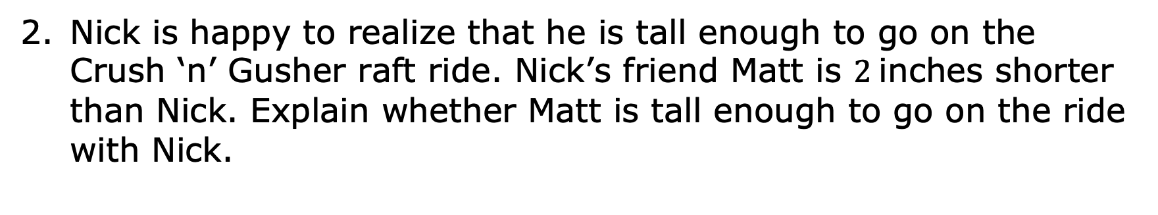
Nick is happy to realize that he is tall enough to go on the Crush ‘n’ Gusher raft ride. Nick’s friend Matt is $2$inches shorter than Nick. Explain whether Matt is tall enough to go on the ride with Nick.
volume 2, pg. 87

Slide 15
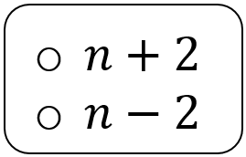
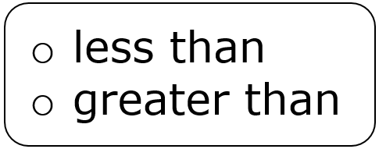
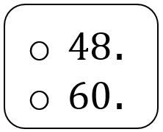
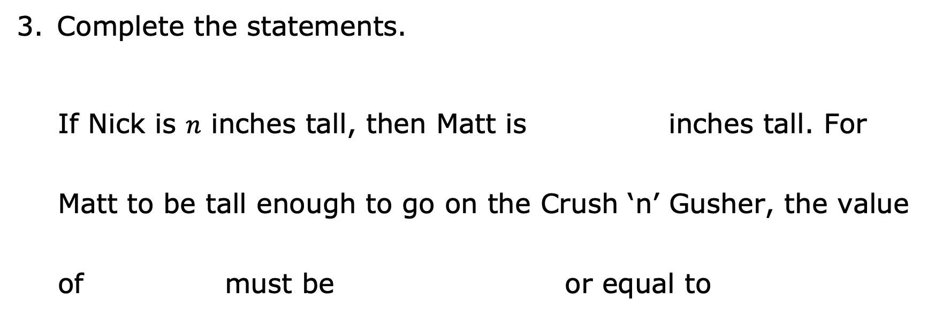
Complete the statements.
If Nick is $n$ inches tall, then Matt is inches tall. For Matt to be tall enough to go on the Crush ‘n’ Gusher, the value of must be or equal to
volume 2, pg. 87

Slide 16
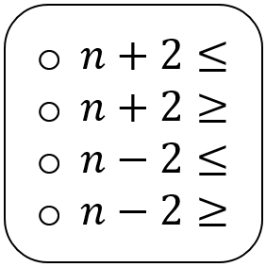
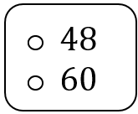
Therefore, the solutions to the inequality represent Nick’s height, which means that Matt could also ride the Crush ‘n’ Gusher.
volume 2, pg. 87

Slide 17
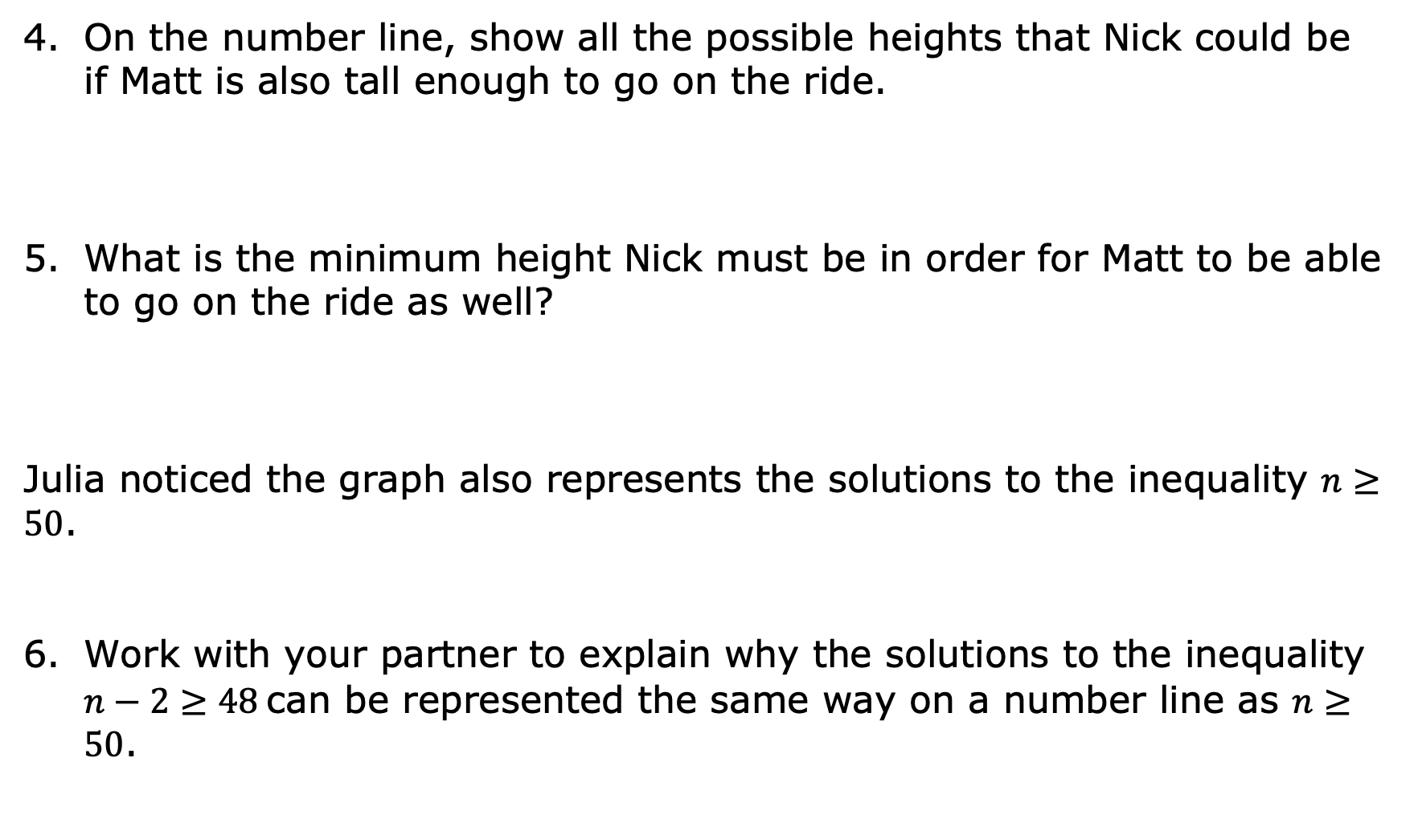
On the number line, show all the possible heights that Nick could be if Matt is also tall enough to go on the ride.
What is the minimum height Nick must be in order for Matt to be able to go on the ride as well?
Julia noticed the graph also represents the solutions to the inequality $n≥50$.
Work with your partner to explain why the solutions to the inequality $n−2≥48$can be represented the same way on a number line as $n≥50$.
volume 2, pg. 88

Slide 18

Bring It Together
volume 2, pg. 88

Slide 19

10.1.4 Bring It Together: Inequalities in Mathematical and Real-World Contexts
Inequalities have an infinite number of solutions. The set of all the solutions of an inequality is called the solution set.
One way to represent the solution set of an inequality is by shading the values on the number line, beginning with the minimum or maximum value, and including all the values to the right or left of it that are included in the solutions set.
The solution set of an inequality includes the values that, when substituted for the variable, make the inequality true.
volume 2, pg. 88

Slide 20
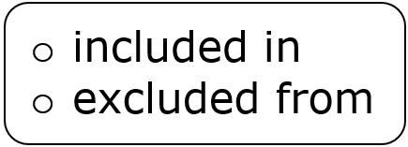
Complete each statement.
A minimum or maximum value represented by an open circle means the value is the solution set.
A minimum or maximum value represented by a closed circle means the value is the solution set.
Graphs representing the solution set of inequalities are helpful when interpreting them in real-world contexts. However, sometimes there are parts of the solution set that may not make sense in a given context.
volume 2, pg. 88

Slide 21
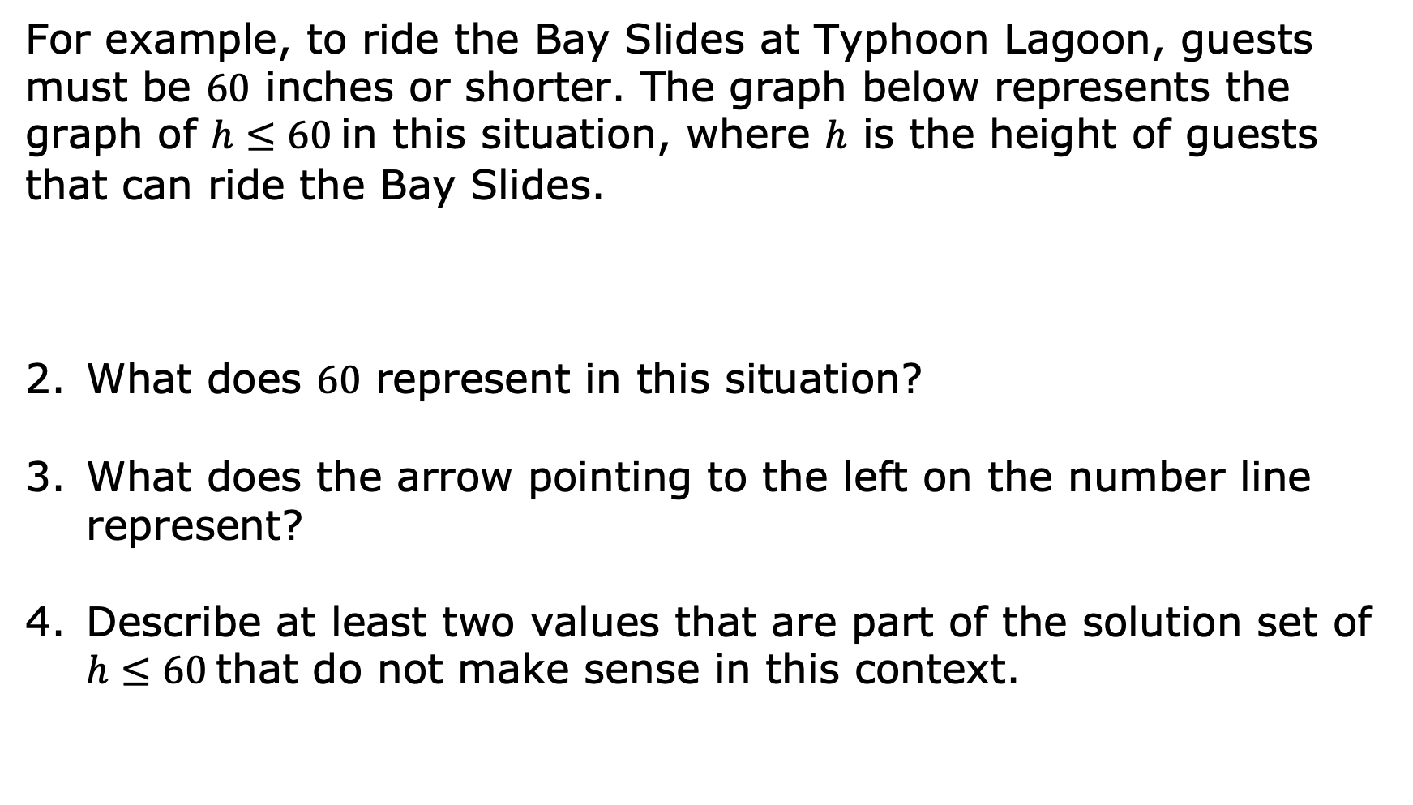
For example, to ride the Bay Slides at Typhoon Lagoon, guests must be $60$ inches or shorter. The graph below represents the graph of $h≤60$ in this situation, where $h$ is the height of guests that can ride the Bay Slides.
What does $60$ represent in this situation?
What does the arrow pointing to the left on the number line represent?
Describe at least two values that are part of the solution set of $h≤60$ that do not make sense in this context.
volume 2, pg. 89

Slide 22

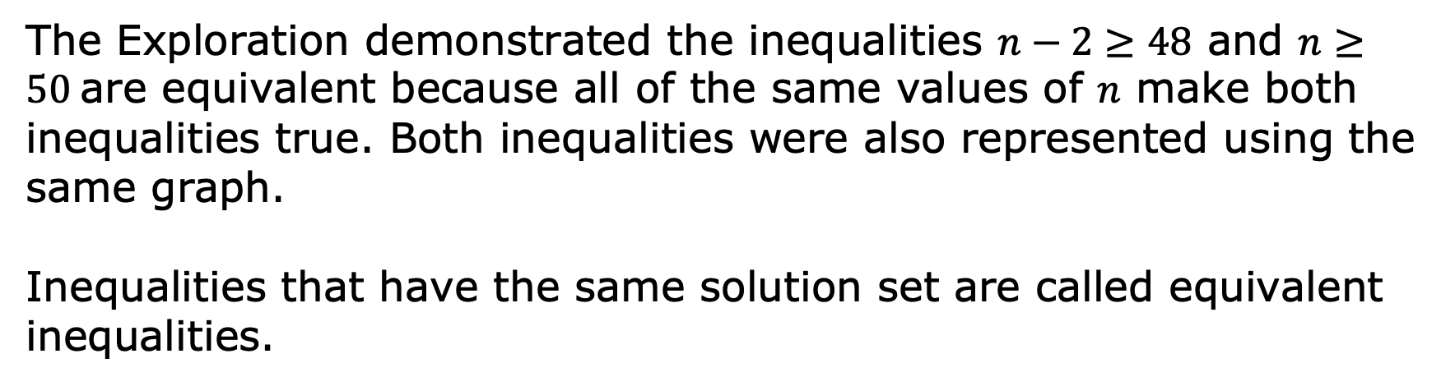
Sometimes there are values that are part of the mathematical solution set that do not make sense in the context. In those cases, the variable may have a constraint (restriction or limitation) placed on it so that the mathematical model is realistic.
The Exploration demonstrated the inequalities $n−2≥48$ and $n≥50$ are equivalent because all of the same values of $n$ make both inequalities true. Both inequalities were also represented using the same graph.
Inequalities that have the same solution set are called equivalent inequalities.
volume 2, pg. 89

Slide 23

Collaboration
volume 2, pg. 90

Slide 24

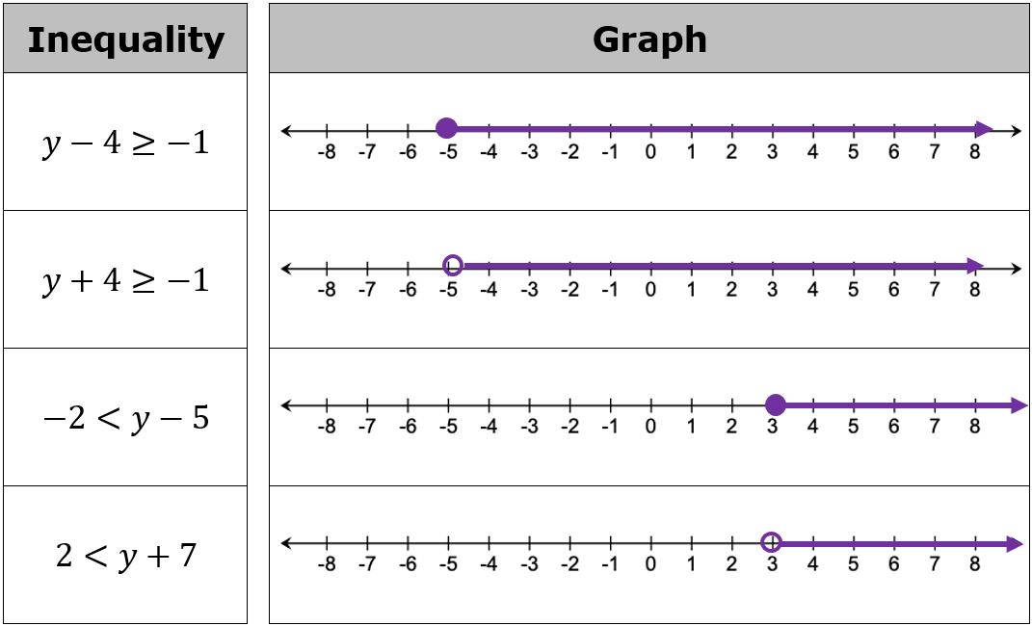
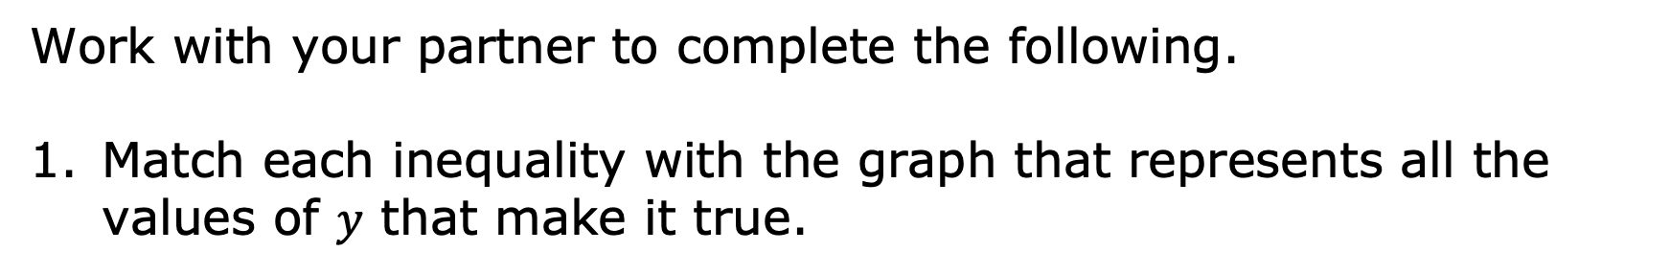
10.1.5 Collaboration: Exploring Inequalities
Work with your partner to complete the following.
Match each inequality with the graph that represents all the values of $y$ that make it true.
volume 2, pg. 90

Slide 25
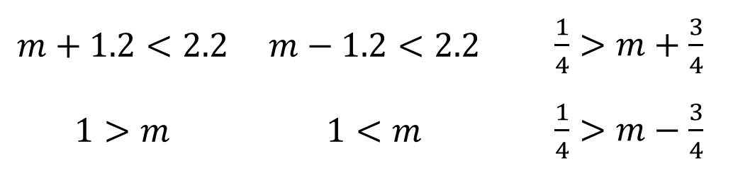
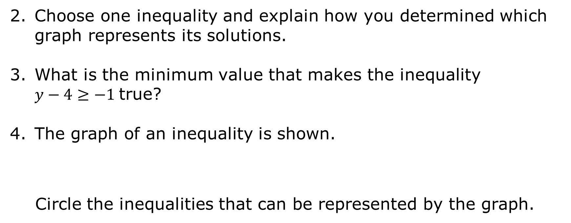
Choose one inequality and explain how you determined which graph represents its solutions.
What is the minimum value that makes the inequality $y−4≥−1$ true?
The graph of an inequality is shown.
Circle the inequalities that can be represented by the graph.
$$m+1.2<2.2$$ | $$m−1.2<2.2$$ | $\frac{1}{4}>m+\frac{3}{4}$
$$1>m$$ | $$1<m$$ | $\frac{1}{4}>m−\frac{3}{4}$
volume 2, pg. 90

Slide 26
Complete the statement.
The inequalities circled above are ____________ inequalities.
Suppose the solution set shown on the number line represents the possible height of Krista’s feet in relation to the surface of the water in her pool when she jumps off the pool’s deck. Describe any possible constraints on the solution set in this context.
Describe the minimum or maximum value that makes this inequality true given the context.
volume 2, pg. 90

Slide 27

Wrap-Up
volume 2, pg. 91

Slide 28
10.1.6 Wrap-Up: Cool Down
Complete the table.
The terms and information used in today’s lesson that I knew were… | Something I wondered during today’s lesson was… | Something I learned during today’s lesson was…
volume 2, pg. 91

